Slide 1
PRESENTATION ON MERGE SORT
By: Vijaykumar R Pai
Shreedhar Hegde

Slide 2
Definition and concepts
Merge sort is also known as divide, conquer and combine because we need to divide the n-element array into two subarrays of size n/2 repeatedly until only one element of array is present and then sort the two subarrays recursively using merge sort and merge the two sorted sub-sequences to form the sorted array.
It was invented by John Von Neumann in 1945.
Merge sort is done in two ways:
Top-down implementation.
Bottom-up implementation.
Merge Sort is quite fast, and has a time complexity of O(n log n). It is also a stable sort, which means the "equal" elements are ordered in the same order in the sorted list.

Slide 3



How merge sort works
To understand merge sort, we take an unsorted array as the following −
We know that merge sort first divides the whole array recursively into equal halves unless the atomic values are achieved. We see here that an array of 8 items is divided into two arrays of size 4.
This does not change the sequence of appearance of items in the original. Now we divide these two arrays into halves.
We further divide these arrays and we achieve atomic value which can no more be divided.

Slide 4



We first compare the element for each list and then combine them into another list in a sorted manner. We see that 14 and 33 are in sorted positions. We compare 27 and 10 and in the target list of 2 values we put 10 first, followed by 27. We change the order of 19 and 35 whereas 42 and 44 are placed sequentially.
In the next iteration of the combining phase, we compare lists of two data values, and merge them into a list of found data values placing all in a sorted order.
After the final merging, the list should look like this −

Slide 5
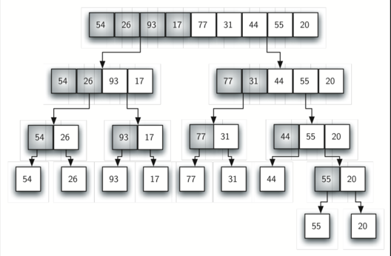
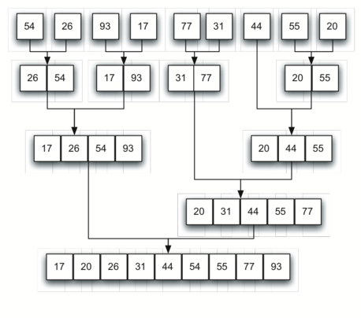

Slide 6
Applications of Merge sort
The e-commerce application
Have you ever noticed on any e-commerce website, they have this section of “You might like”, they have maintained an array for all the user accounts and then whichever has the least number of inversion with your array of choices, they start recommending what they have bought or they like. This is one of them.
And some e-commerce website like policybazaar.com, trivago.com etc use their search engine for collecting data from other website to provide minimum cost of booking hotel room or purchasing product.
Telephone Directory − The telephone directory stores the telephone numbers of people sorted by their names, so that the names can be searched easily.
Dictionary − The dictionary stores words in an alphabetical order so that searching of any word becomes easy.

Slide 7
Pseudocode
procedure mergesort( var a as array )
if ( n == 1 ) return a
var l1 as array = a[0] ... a[n/2]
var l2 as array = a[n/2+1] ... a[n]
l1 = mergesort( l1 )
l2 = mergesort( l2 )
return merge( l1, l2 )
end procedure
procedure merge( var a as array, var b as array )
var c as array

Slide 8
while ( a and b have elements )
if ( a[0] > b[0] )
add b[0] to the end of c
remove b[0] from b
else
add a[0] to the end of c
remove a[0] from a
end if
end while
while ( a has elements )
add a[0] to the end of c
remove a[0] from a
end while

Slide 9
while ( b has elements )
add b[0] to the end of c
remove b[0] from b
end while
return c
end procedure

Slide 10
Program
#include<stdio.h>
int arr[20]; // array to be sorted
int main()
{
int n,i;
printf("Enter the size of array\n"); // input the elements
scanf("%d",&n);
printf("Enter the elements:\n");
for(i=0;i<n;i++)
scanf("%d",&arr[i]);
merge_sort(arr,0,n-1); // sort the array

Slide 11
printf("Sorted array:"); // print sorted array
for(i=0;i<n;i++)
printf("%d\t\t",arr[i]);
return 0;
}
int merge_sort(int arr[],int low,int high)
{
int mid;
if(low<high)
{
mid=(low+high)/2;
// Divide and Conquer

Slide 12
merge_sort(arr,low,mid);
merge_sort(arr,mid+1,high);
// Combine
merge(arr,low,mid,high);
}
return 0;
}
int merge(int arr[],int l,int m,int h)
{
int arr1[10],arr2[10]; // Two temporary arrays to hold the two arrays to be merged
int n1,n2,i,j,k;
n1=m-l+1;
n2=h-m;

Slide 13
for(i=0;i<n1;i++)
arr1[i]=arr[l+i];
for(j=0;j<n2;j++)
arr2[j]=arr[m+j+1];
arr1[i]=9999; // To mark the end of each temporary array
arr2[j]=9999;
i=0;j=0;
for(k=l;k<=h;k++) //process of combining two sorted arrays
{
if(arr1[i]<=arr2[j])
arr[k]=arr1[i++];
else
arr[k]=arr2[j++];
}
return 0;
}

Slide 14
Expected Output
Enter the size of array : 8
Enter the elements:
14
33
27
10
35
19
42
44
Sorted array: 10 14 19 27 33 35 42 44

Slide 15
Viva Questions
1. What is the output of merge sort after the 1st pass given the following sequence of numbers: 25 57 48 37 12 92 86 33 a. 48 25 37 12 57 86 33 92 b. 12 25 33 37 48 57 86 92 c.12 25 33 37 48 57 86 92 d. 25 57 37 48 12 92 33 86
Ans:d
2. What is the output of merge sort after the 2nd pass given the following sequence of numbers : 3,41,52,26,38,57,9,49 a. 3,26,41,52,38,9,49,57 b. 3,26,41,52,9,38,49,57 c. 3,26,38,9,49,57,41,52 d. 3,26,41,52,38,49,57,9
Ans. b

Slide 16
3. What is the output of merge sort after the 3rd pass given the following sequence of numbers: 25 57 48 37 12 92 86 33 a. 12 25 33 37 48 57 86 92 b. 12 25 33 37 48 57 86 92 c.12 25 33 37 48 57 86 92 d. 25 57 37 48 12 92 33 86
Ans:a
4. You have to sort 1 GB of data with only 100 MB of available main memory. Which sorting technique will be most appropriate?
a. Heap sort b. Merge sort c. Quick sort d. Insertion sort
Ans:b

Slide 17
5. Which of the following is true about merge sort?
a. Merge Sort works better than quick sort if data is accessed from slow sequential memory
b. Merge Sort is stable sort by nature
c. Merge sort outperforms heap sort in most of the practical situations
d. All of the above
Ans:b
6. What is the best sorting algorithm to use for the elements in array are more than 1 million in general?
a. Merge sort
b. Bubble sort
c. Quick sort
d. Insertion sort
Ans:c

Slide 18
THANK YOU

